Slide 1
11.3-11.5
Properties of Liquids,
Phase Changes, & Vapor Pressure

Slide 2
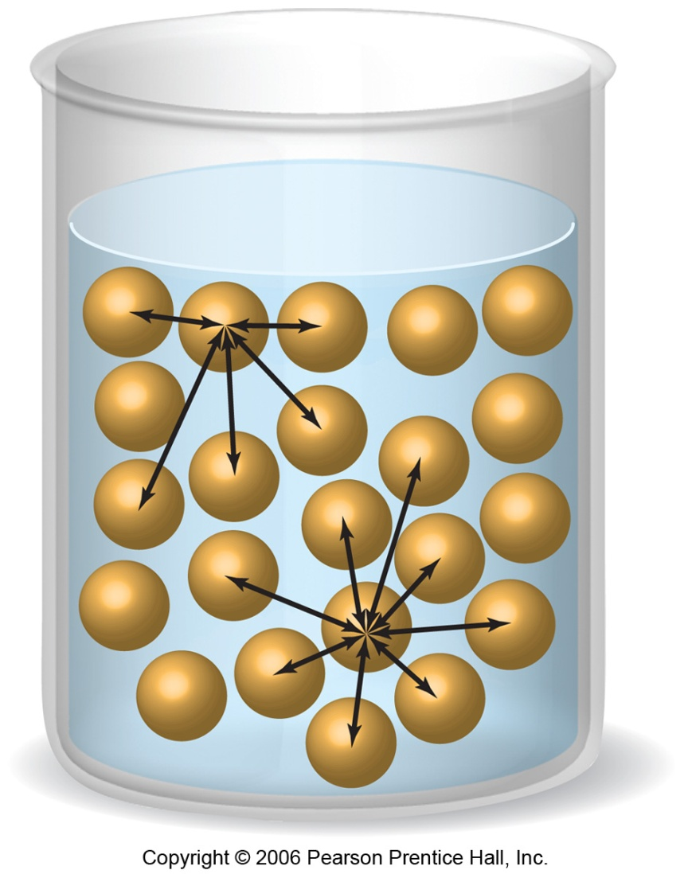
Intermolecular Forces Affect Many Physical Properties
The strength of the attractions between particles can greatly affect the properties of a substance or solution.

Slide 3
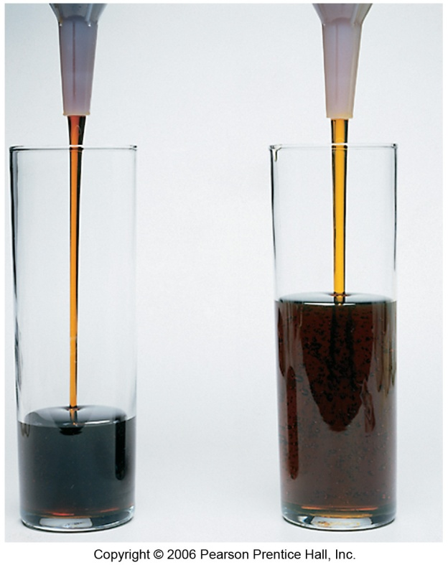
Viscosity
Resistance of a liquid to flow is called viscosity
It is related to the ease with which molecules can move past each other
More viscous liquids take longer to flow through the tube pictured here
Viscosity increases with stronger intermolecular forces and molecular weight
Viscosity decreases with higher temperature… WHY???

Slide 4

Surface Tension
Molecules on the interior are attracted in all directions
Molecules on the surface are pulled inward, reducing the surface area
Surface Tension is the energy required to increase the surface area of a liquid by a unit amount
  EX: The surface tension of H2O at 20˚C is 7.3 x 10⁻²J/m². Thus, 7.3 x 10⁻²J must be supplied to increase the surface area of water by 1m².

Slide 5
Cohesive Forces
Adhesive Forces
Intermolecular forces that bind similar molecules to one another
Ex: hydrogen bonding
Intermolecular forces between unlike substances, causing the substance to bind to a surface
Ex: water “wetting” a glass

Slide 6
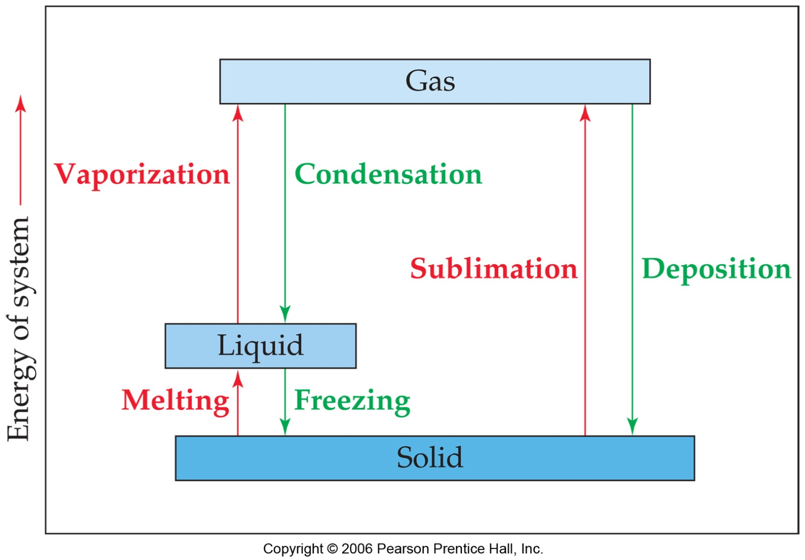
Phase Changes

Slide 7
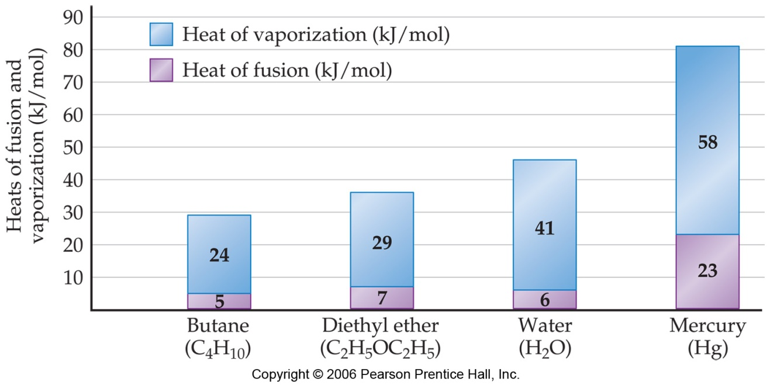
Energy Changes Associated with Changes of State
Heat of Fusion: Energy required to change a solid at its melting point to a liquid.
Heat of Vaporization: Energy required to change a liquid at its boiling point to a gas.
Heat of Sublimation: Energy required to change a solid directly to a gas.

Slide 8
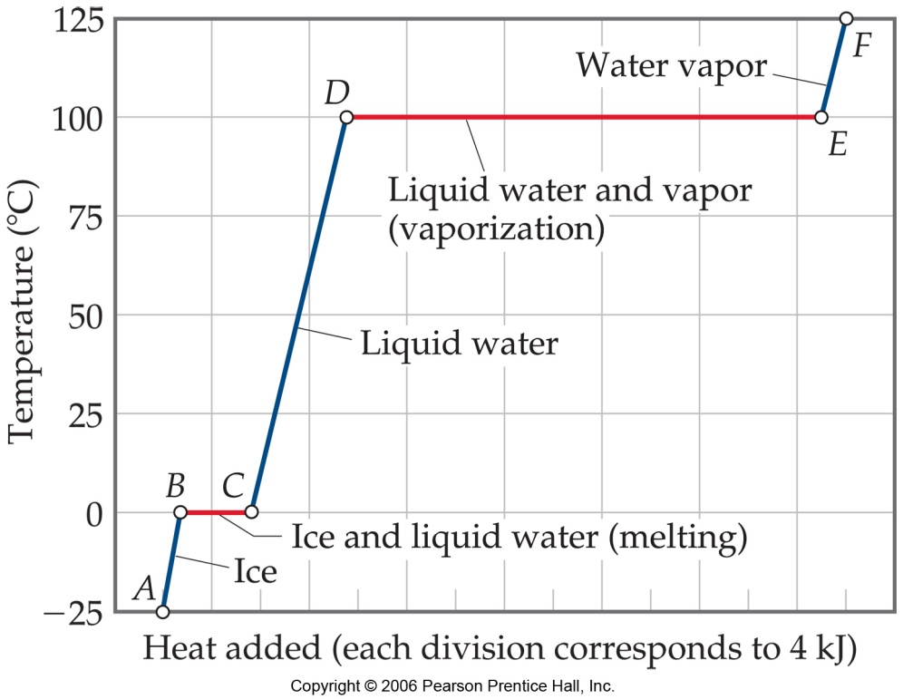
Energy Changes Associated with Changes of State
The heat added to the system at the melting and boiling points goes into pulling the molecules farther apart from each other.
The temperature of the substance does not rise during the phase change.
After the phase change is complete, the temperature will rise with further addition of heat

Slide 9
SAMPLE EXERCISE 11.4 Calculating ΔH for Temperature and Phase Changes
Calculate the enthalpy change upon converting 1.00 mol of ice at –25°C to water vapor (steam) at 125°C under a constant pressure of 1 atm. The specific heats of ice, water, and steam are 2.09 J/g-K, 4.18 J/g-K and 1.84 J/g-K, respectively. For H₂O, ΔH_{fus} = 6.01 kJ/mol and ΔH_{vap} = 40.67 kJ/mol.

Slide 10
Criticals
Critical Temperature:
  The highest temperature at which a distinct liquid phase can form
  Above this temp, no amount of pressure can cause liquefaction
Critical Pressure:
  The pressure required to bring about liquefaction at this critical temperature
Nonpolar molecules with low weights (weak intermolecular forces) have low criticals.
Polar molecules with high weights (strong molecular forces) have high criticals.
Hydrogen bonding (H₂O, NH₃) creates very high criticals

Slide 11
Vapor Pressure
At any temperature, some molecules in a liquid have enough energy to escape.
As the temperature rises, the fraction of molecules that have enough energy to escape increases.
  The pressure exerted by the vapor above the liquid also increases
After time, the pressure of the vapor above will become constant….we call this its vapor pressure
Weaker IMF correlate to higher VP!

Slide 12
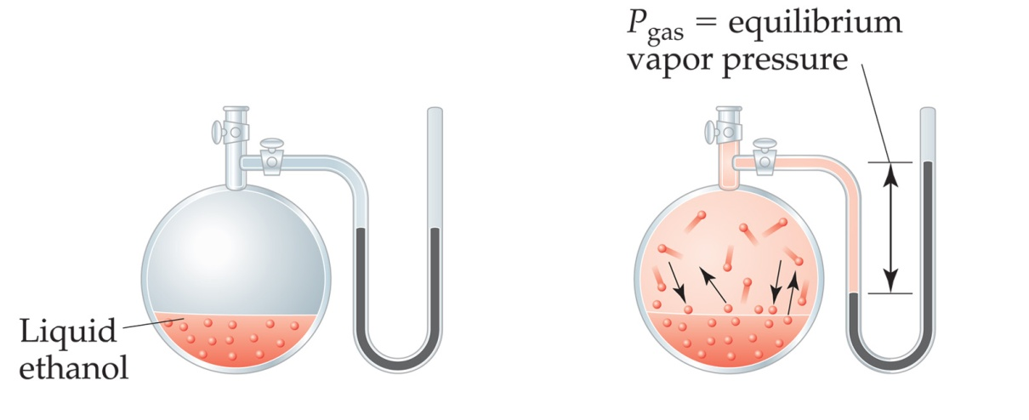
Vapor Pressure
As more molecules escape the liquid, the pressure they exert increases.

Slide 13

Vapor Pressure
The liquid and vapor reach a state of dynamic equilibrium: liquid molecules evaporate and vapor molecules condense at the same rate.

Slide 14
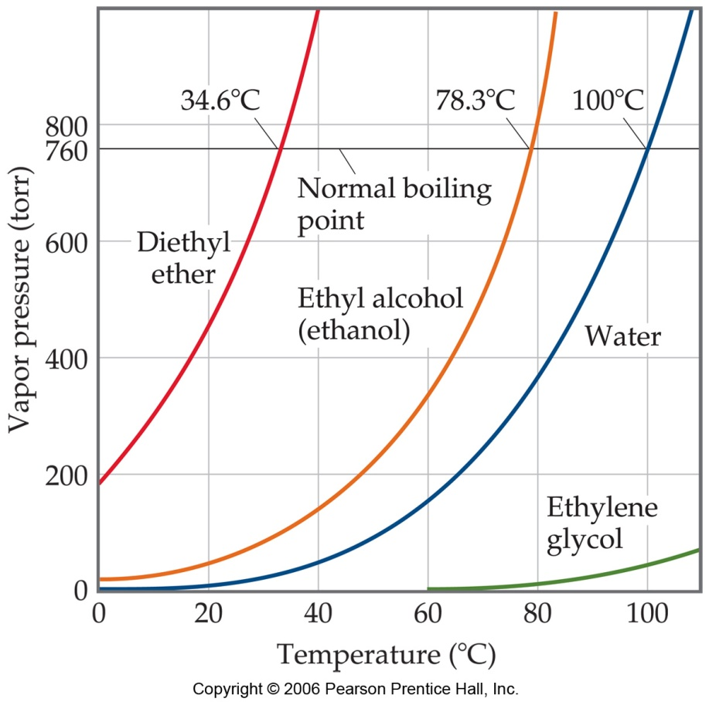
Vapor Pressure
The boiling point of a liquid is the temperature at which its vapor pressure equals atmospheric pressure.
The normal boiling point is the temperature at which its vapor pressure is 760 torr.

